Slide 1
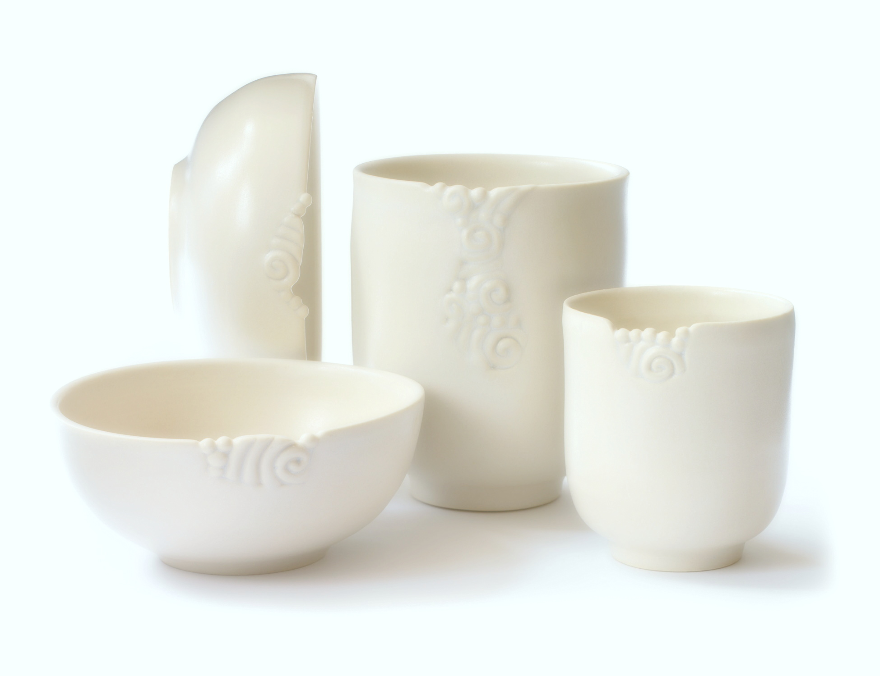
CERAMICS NETWORK
BROKEN CERAMICS
Rasif Tahmid
ID: 11.01.04.011
A.K.M. Mahmud
ID: 11.01.04.021
Farzana Yeasmeen Sabah
ID: 11.01.04.027
Sumaiya Bushra
ID: 11.01.04.028

Slide 2
Executive summary
Overview of Ceramic Industry:
Establishment of 1st Ceramic Industry:1962
People Ceramic Industries Ltd (PCI) pioneered the manufacture of porcelain tableware.
The total capacity of ceramic tableware manufacturing companies is nearly 40,000 tones a year as of 2012, of which an average of 48 percent is exported and the remaining 52 percent is used in the domestic market.
Ceramic tableware Market: Shinepukur, Monno Ceramics, Bengal Fine Ceramics, Standard Ceramics, Peoples & National Ceramics.
Manufacturers of tiles & sanitary wares: RAK, Fu Wang, China-Bangla, FARR, Modhumoti, ATI, Sunflower, Great Wall, Dhaka-Sanghai, Mir

Slide 3
Executive summary
Overview of Ceramic Industry:
The Export Promotion Bureau (EPB) data showed that in the July-May period in FY 2012-13, the export earnings from ceramic goods amounted to almost $34.42 million with a 10 percent growth.
Bangladesh exports ceramic products to about 50 countries including the US, the UK, Italy, Germany, France, Spain, Norway, Sweden, Turkey, Poland, Australia, New Zealand, Canada, Mexico, Brazil and Chile etc.
Local ceramic-ware manufacturing industry is expecting a steady growth with a US $100 million return from exports by 2015 as the global market favors more shipment from Bangladesh.
.

Slide 4
Executive summary
WHY DID WE CHOOSE “CERAMIC INDUSTRY”?
Foreign delegates frequently visit the market for exploring & purchasing our products. They go round the market to choose the designs, materials etc. of the products & to have conferences with the relevant companies.
At present times, due to the political unrest, the business has become quite unstable. The foreign delegates cannot visit frequently in this situation and thus market is going downwards.
Moreover, in the modern world, people are more conscious about time. Almost all industries are now dependant on web based communication.
So it is has become a necessity to develop a web platform that can represent our country’s ceramic market in front of the world; so that the foreign delegates can visit our market whenever they want without facing the hustle of traffic jam, strikes, unrest situation etc.

Slide 5
Goals
A “search filtering option” by which the buyers can search more precisely.
Latest offers that the companies provide will be featured aside.
Buyers can choose from the given designs of various companies and can also provide their own designs.

Slide 6
Goals
Buyers can submit their requirements & the companies will offer their prices according to those requirements. As a result, the buyers can choose which company’s offer is more profitable for them.
Local dealers can also purchase products via this website from industries.
The basic information of the registered Ceramics showrooms of Bangladesh will be displayed so that buyers from country/ outside can contact them.

Slide 7
Project Platform
HTML5
CSS3
PHP/ASP.NET
JAVASCRIPT
JQUERY
MYSQL

Slide 8
Project current status
This is a new idea developed for the betterment of our ceramic industry.
We have organized the ideas altogether and shall start working soon .

Slide 9
Opportunities of developments
The very first thing that we are concerned about is we have to convince all industries to bring them under one platform as the market is highly competitive and giant companies are rival to each other.
As smartphones and tablet pc is growing faster we have to make our web application in such a way so that it should be more compatible for any device.
The design of our website should be sleeker and more eye catching.
As buyers have to visit Bangladesh, he/she have to worried for foods, hotels and travelling to industries. So our website might provide them the links of such things as well so he/she do not have to spend a lot of time for searching them.

Slide 10
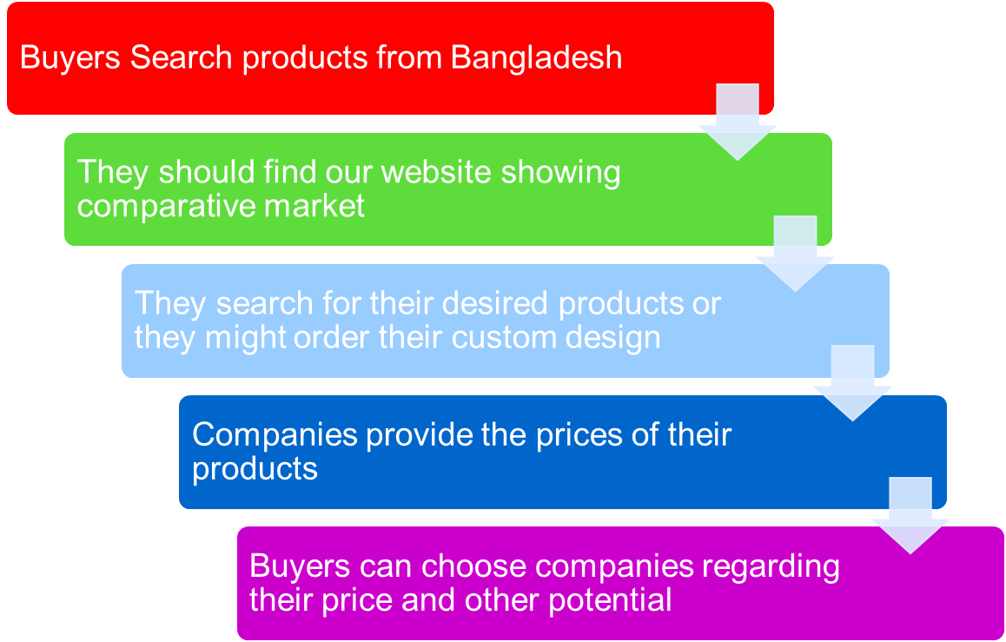
Flow chart

Slide 11
Thank you
Any Questions?

